Slide 1

Basic operations with PnP Core and Authentication Manager
Bernd Rickenberg
Chefudvikler
Pointwork

Slide 2
Agenda basic operations
Why use PnP Core?
Simple example
Closing remarks

Slide 3
Why use PnP core for basic operations?
Repeatability
Code is tested
Follows established patterns
Simplicity
Replace large code blocks with existing PnP methods
Wraps complex functionality in easy to consume methods
Supportability
Support for common and complex actions
Monthly updates to address community reported bugs and include enhancements
Notes:
Good example: EnsureFolder(this Web web, Folder parentFolder, string folderPath)

Slide 4
Plain CSOM example
using (clientContext)
{
var list = clientContext.Web.Lists.Add(new ListCreationInformation
{
Title = "MyList",
Url = "lists/mylist",
TemplateType = (int) ListTemplateType.GenericList
});
clientContext.Load(list);
clientContext.ExecuteQuery();
}

Slide 5
PnP core web extensions example
using (clientContext)
{
var list = clientContext.Web.CreateList(ListTemplateType.GenericList, "MyList", false);
}

Slide 6
Extensions methods overview
Called AppModelExtensions in PnP core component
Source code in GitHub repo: https://github.com/OfficeDev/PnP-Sites-Core/tree/master/Core/OfficeDevPnP.Core/AppModelExtensions
462 extensions methods (09-2016), grouped by functional areas
Notes:
Most of the time the extensions API is consistent. A few exceptions:
Some method in ListExtensions deal with security or property bag.
Property bag should have it’s own area.
The individual GetPropertyBagValue methods should be replaced with generics instead of having one for each type.
Id is sometimes spelled ID or Id.
Exists is used as prefix and postfix in method names

Slide 7
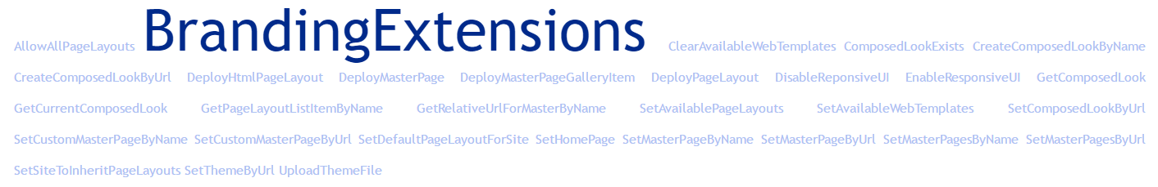

Slide 8
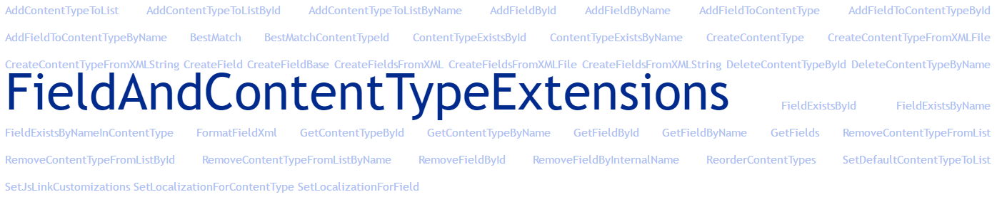
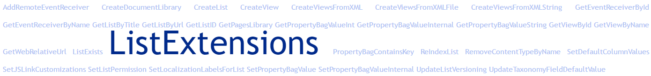

Slide 9

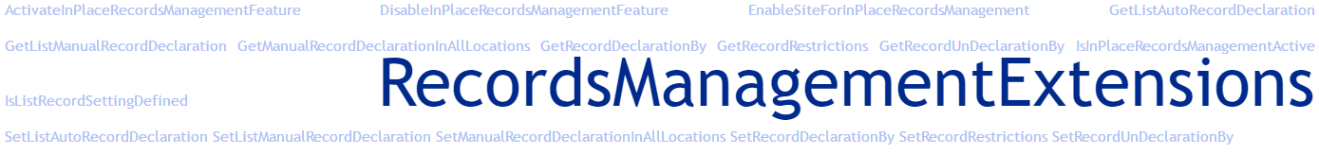
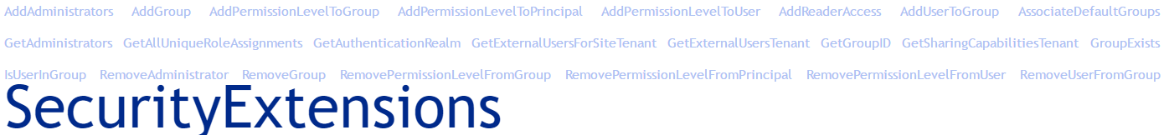

Slide 10
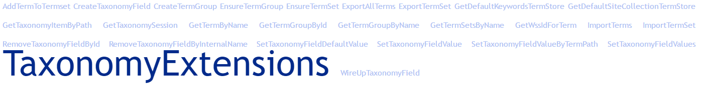
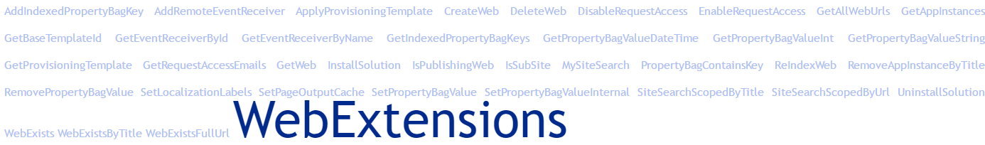

Slide 11
PnP Authentication Manager

Slide 12
Agenda authentication manager
Why do I need to authenticate using the PnP Authentication Manager class
Authentication Manager overview
App-Only and Azure AD authentication setup

Slide 13
Authentication Manager use cases
Using CSOM code always requires you to have a ClientContext object:
Using the OOB SharePoint Add-In templates
Using custom code such as the PnP Authentication Manager when outside of an add-in or SharePointContextProvider complicates things
Use standard CSOM code - new ClientContext() – and set credentials
Use ADAL or ADALJS when working with Azure AD add-ins
var spContext = SharePointContextProvider.Current.GetSharePointContext(Context);
using (var clientContext = spContext.CreateUserClientContextForSPHost())
{ // your code }
Notes:
CSOM is just a managed code wrapper for SharePoint REST endpoint (_api or _vti_bin/client.svc)
OAuth is used in both on-prem low-trust, on-prem high-trust and cloud scenarios. OAuth is not used when using WindowsCredentials.
Note: On domain joined machines (AD or AAD) you can use credential cache to access resources (SharePoint on-prem or Office 365)

Slide 14
Introduction to the PnP Authentication Manager
Class in the PnP Core library that bundles various authentication options (credentials, app-only, interactive) against different targets (SharePoint Online, SharePoint 2013 and SharePoint 2016)
Getting started with the PnP Authentication Manager involves:
Adding the PnP Core NuGet package
Adding the ADAL NuGet package
using Microsoft.SharePoint.Client;
using OfficeDevPnP.Core;
…
ClientContext cc = new AuthenticationManager().GetSharePointOnlineAuthenticatedContextTenant(siteUrl, userName, password);

Slide 15
Authentication
User credentials or App-Only?
Credentials
App-only
Office 365 or On-Premises?
Office 365 or On-Premises?
Office 365
Office 365 + On-Premises
Use AzureADAppOnly Authentication
Use AppOnly Authentication
Office 365
On-Premises
with ADFS
On-Premises
Use Office365 Authentication
Use NetworkCredentials Authentication
ADFSUserNameMixed Authentication
Notes:
ADFSUserNameMixed uses WS-Trust and WS-Federation protocol based on SAML 1.1 tokens, is typically used to setup trust for B2B scenarios

Slide 16
Authentication Manager: Office 365
Basic options when using registering the add-in via SharePoint:
Credentials:
GetSharePointOnlineAuthenticatedContextTenant
GetWebLoginClientContext (= interactive login!)
App-Only:
GetAppOnlyAuthenticatedContext
Basic options when using registering the add-in via Azure AD:
Credentials:
GetAzureADNativeApplicationAuthenticatedContext (= interactive login!)
GetAzureADAccessTokenAuthenticatedContext (= reuse access token)
App-Only:
GetAzureADAppOnlyAuthenticatedContext
GetAzureADAccessTokenAuthenticatedContext (= reuse access token)
Notes:
All methods running in user context require a password supplied somehow.
SharePointContextProvider does not need that.

Slide 17
Authentication Manager: On-Premises
Basic options when using registering the add-in via SharePoint:
Credentials:
GetNetworkCredentialAuthenticatedContext
GetADFSUserNameMixedAuthenticatedContext
App-Only:
GetAppOnlyAuthenticatedContext
Notes:
Network credentials: Returns a SharePoint on-premises / SharePoint Online Dedicated ClientContext object
ADFS mixed: Returns a SharePoint on-premises ClientContext for sites secured via ADFS
App-only: Returns an app only ClientContext object

Slide 18
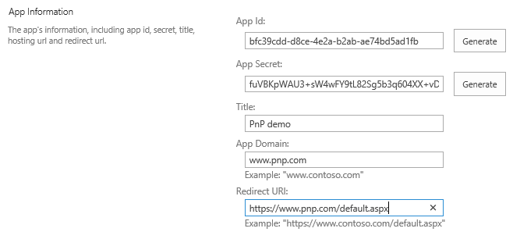
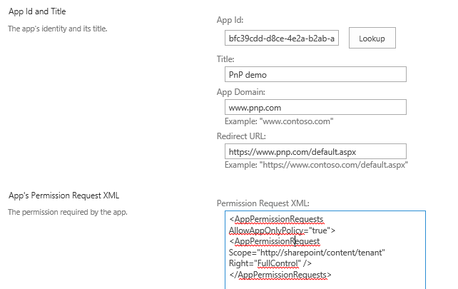
App-Only setup using SharePoint
Register an app principal via the AppRegNew page in SharePoint:
_layouts/15/appregnew.aspx
Generate App Id and Secret
Provide domain information
Grant permissions to it via the AppInv page in SharePoint:
_layouts/15/appinv.aspx
Lookup the earlier registered app
Provide permission XML, don’t forget the AllowAppOnlyPolicy=“true”
Notes:
Registering an add-in with SharePoint manually – e.g. if it is not a provider hosted add-in such a console application or an web application running on an Raspberry PI.

Slide 19
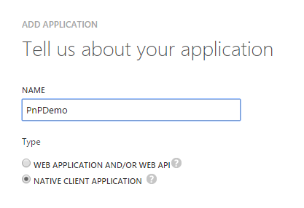
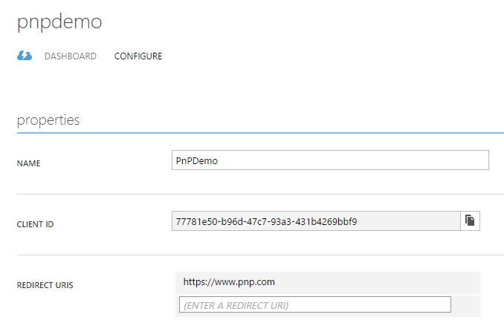
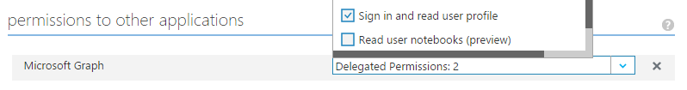
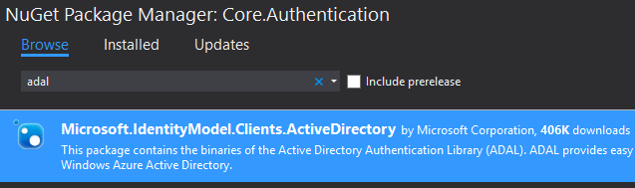
Interactive login setup using Azure AD
Create an Native Client Application in Azure AD:
Redirect URI can be anything
Copy the Client ID
Grant Delegated Permissions
Once the PnP Core NuGet package has been added also add the Microsoft.IdentityModel.Clients.ActiveDirectory (=ADAL) package to your project
Notes:
Azure AD add-ins (as opposed to SharePoint add-ins). You can give the add-in coarse grained access to everything in the Office 365 tenant.

Slide 20
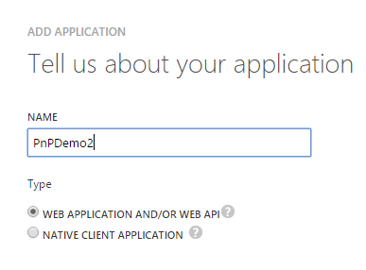
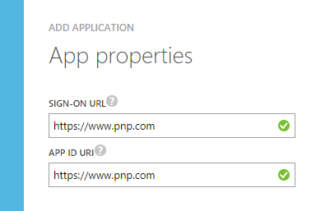
App-Only setup using Azure AD – part 1
Create a Web Application in Azure AD:
Sign-on URL can be anything
App ID must be unique in your tenant
Add the PnP Core and ADAL NuGet packages
Create a self signed certificate and prepare for using it:
.\Create-SelfSignedCertificate.ps1 –CommonName “PnP” –StartDate 2016-01-01 –EndDate 2018-01-01
.\Get-SelfSignedCertificateInformation.ps1
Scripts are available from:
https://github.com/OfficeDev/PnP-Partner-Pack/tree/master/scripts

Slide 21
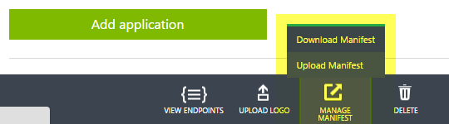
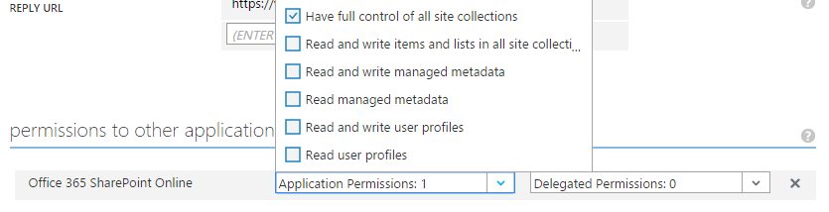
App-Only setup using Azure AD – part 2
Replace the KeyCredentials section obtained in the previous step in the app manifest via downloading, updating and again uploading the manifest
Grant Application Permissions to your app in Azure AD

Slide 22
Q&A

